Slide 1
A Technical Seminar On
Enterprise Resource Planning
By
Name: Ajay Singh
Hall Ticket No: (21X01A6602)
Under the guidance of
Mr. M R Chaitanya, M. Tech
Assistant Professor
DEPARTMENT OF COMPUTER SCIENCE AND ENGINEERING
NARSIMHA REDDY ENGINEERING COLLEGE (UGC-AUTONOMOUS)
(Approved by AICTE, Affiliated to JNTUH, Accredited by NBA & NAAC with A-Grade)
Maisammaguda (V), Kompally, Secunderabad, Telangana-500100.
2021-2025

Slide 2
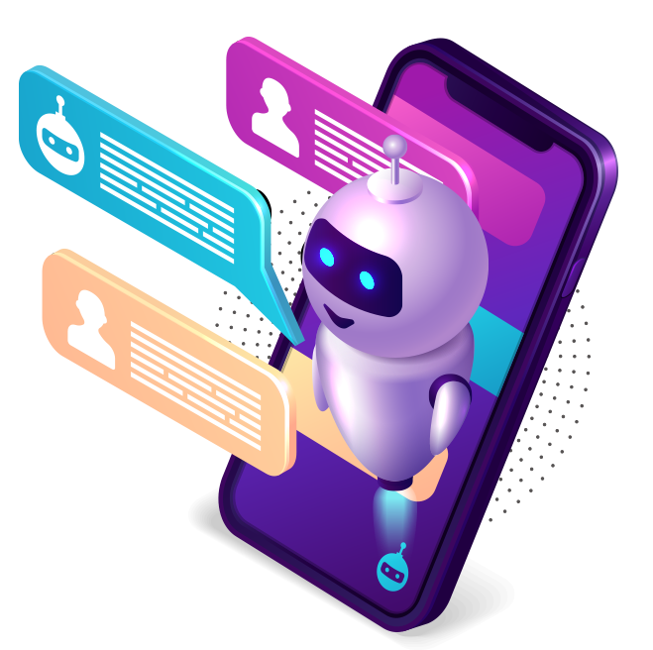
Contents :
Introduction to Chatbots
Abstract
Types of Chatbots
Literature survey
Existing system
Problem defination
Conclusion
Chatbot
Elevating engagement, Efficiency and Satisfaction

Slide 3

Contents :
Introduction to Chatbots
Abstract
Types of Chatbots
Literature survey
Existing system
Problem definition
System Requirements
Conclusion
Chatbot

Slide 4
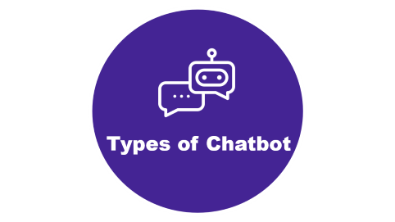






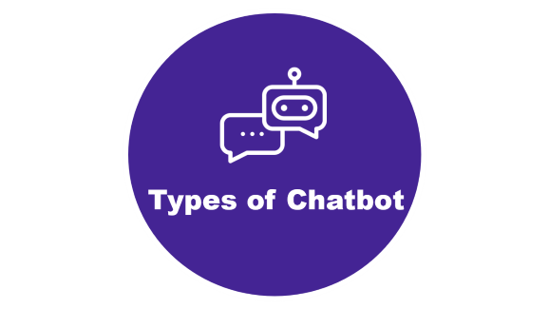



Slide 5

Introduction

Slide 6
Introduction
Chatbots are computer programs that simulate human conversation, using artificial intelligence to interact with users and provide assistance.
The first chatbot, named Eliza, was created by Joseph Weizenbaum in 1966.

Slide 7

Abstract

Slide 8
Abstract
It also known as conversational interfaces getting answers from software involved search engines or form-filling.
Chatbots allow users to ask questions naturally, just like they would address a human.
The core technology behind chatbots is Natural language processing (NLP).

Slide 9

Types of Chatbot

Slide 10
Types of chatbot
Menu-Based Bots: Offer predefined options for users to choose from.
Rule-Based Bots: Follow predefined rules or keywords to provide responses.
NLP (Natural Language Processing) Bots: Use AI to understand natural language and context.
ML (Machine Learning) Bots: Adapt based on user interactions and learn over time.
Hybrid Bots: Combine rule-based and AI approaches.
Voice Bots: Interact via voice commands.

Slide 11

Timeline

Slide 12
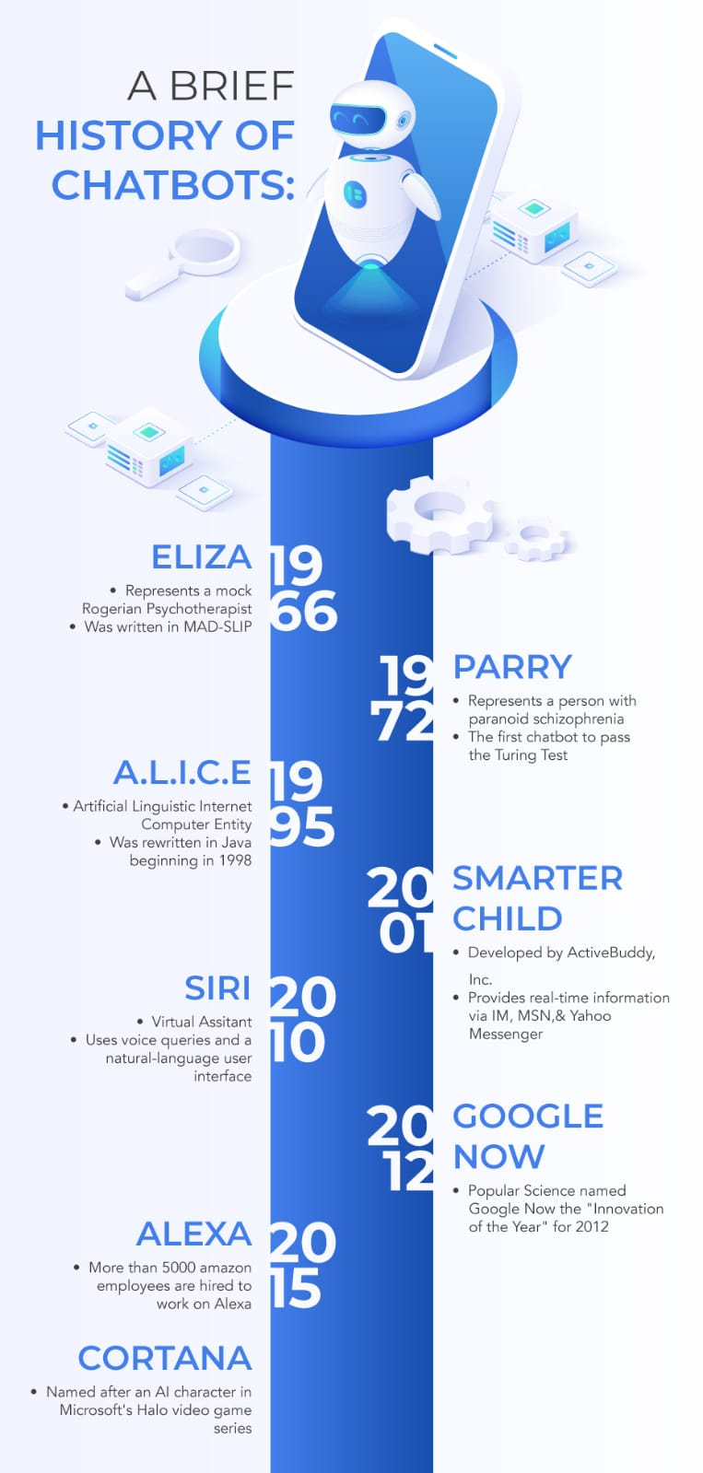
Timeline

Slide 13

Literature survey

Slide 14
Literature survey
Emerging Trends: Highlighting advancements in NLP, AI integration, user-centric design, and ethical considerations.
Methodological Insights: Providing guidance on search strategies, inclusion criteria, and analysis methods for conducting robust literature surveys.
Practical Implications: Offering insights for future research, addressing challenges, and informing the design of chatbots for specific applications.

Slide 15
Existing system of chatbot
01
02
03
04
User Interface: Platform for interaction, like messaging apps or website widgets.
NLU: Analyzes input to understand intent and context.
NLG: Generates coherent responses based on context.
Backend Systems: Accesses databases or APIs for tasks.
Integration: Extends functionality with external services or APIs.
Analytics: Monitors interactions to enhance performance.
Dialogue Management: Controls conversation flow based on input and context.
Error Handling: Manages errors or uncertainties in user input.

Slide 16
Existing system of chatbot
01
02
03
04
User Interface: Platform for interaction, like messaging apps or website widgets.
NLU: Analyzes input to understand intent and context.
NLG: Generates coherent responses based on context.
Backend Systems: Accesses databases or APIs for tasks.
Integration: Extends functionality with external services or APIs.
Analytics: Monitors interactions to enhance performance.
Dialogue Management: Controls conversation flow based on input and context.
Error Handling: Manages errors or uncertainties in user input.

Slide 17
Existing system of chatbot
01
02
03
04
User Interface: Platform for interaction, like messaging apps or website widgets.
NLU: Analyzes input to understand intent and context.
NLG: Generates coherent responses based on context.
Backend Systems: Accesses databases or APIs for tasks.
Integration: Extends functionality with external services or APIs.
Analytics: Monitors interactions to enhance performance.
Dialogue Management: Controls conversation flow based on input and context.
Error Handling: Manages errors or uncertainties in user input.

Slide 18
Existing system of chatbot
01
02
03
04
User Interface: Platform for interaction, like messaging apps or website widgets.
NLU: Analyzes input to understand intent and context.
NLG: Generates coherent responses based on context.
Backend Systems: Accesses databases or APIs for tasks.
Integration: Extends functionality with external services or APIs.
Analytics: Monitors interactions to enhance performance.
Dialogue Management: Controls conversation flow based on input and context.
Error Handling: Manages errors or uncertainties in user input.

Slide 19
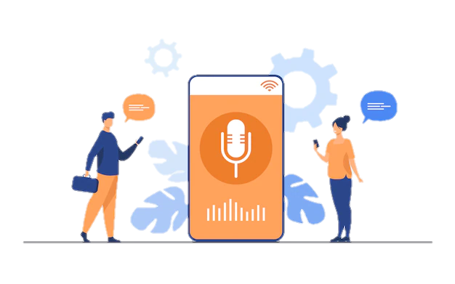
Problem Defination
Limited Understanding: Chatbots struggle with accurately interpreting natural language, causing user frustration.
Handling Complex Queries: They struggle with nuanced or complex queries, providing inadequate responses.
Lack of Context Awareness: Chatbots often lack the ability to understand context, resulting in repetitive or irrelevant responses.
Emotional Intelligence: Lack of empathy or emotional understanding hampers user engagement.
Security and Privacy: Concerns arise over mishandling sensitive data or vulnerabilities.
Inflexibility: Chatbots rigidly follow scripts, making them unable to handle unexpected queries.
Maintenance Challenges: Keeping chatbots updated with evolving needs requires ongoing resources and effort.
Integration Issues: Difficulty integrating with existing systems limits their effectiveness.

Slide 20
Problem Defination
Limited Understanding: Chatbots struggle with accurately interpreting natural language, causing user frustration.
Handling Complex Queries: They struggle with nuanced or complex queries, providing inadequate responses.
Lack of Context Awareness: Chatbots often lack the ability to understand context, resulting in repetitive or irrelevant responses.
Emotional Intelligence: Lack of empathy or emotional understanding hampers user engagement.
Inflexibility: Chatbots rigidly follow scripts, making them unable to handle unexpected queries.
Security and Privacy: Concerns arise over mishandling sensitive data or vulnerabilities.
Integration Issues: Difficulty integrating with existing systems limits their effectiveness.
Maintenance Challenges: Keeping chatbots updated with evolving needs requires ongoing resources and effort.

Slide 21

Conclusion
Integration with Voice Assistants: Chatbots will increasingly integrate with voice assistants like Siri, Alexa, and Google Assistant to provide multimodal interactions.
Chatbots are increasingly present in businesses and often are used to automate tasks that do not require skill-based talents.
Rather than replacing humans, chatbots can complement our abilities.
They handle repetitive tasks, answer common queries, and free up human agents for more complex issues.
A study by Forrester (June 2017) predicted that 25% of all jobs would be impacted by AI technologies by 2019.

Slide 22


Presented By :
Ajay Singh

